Slide 1


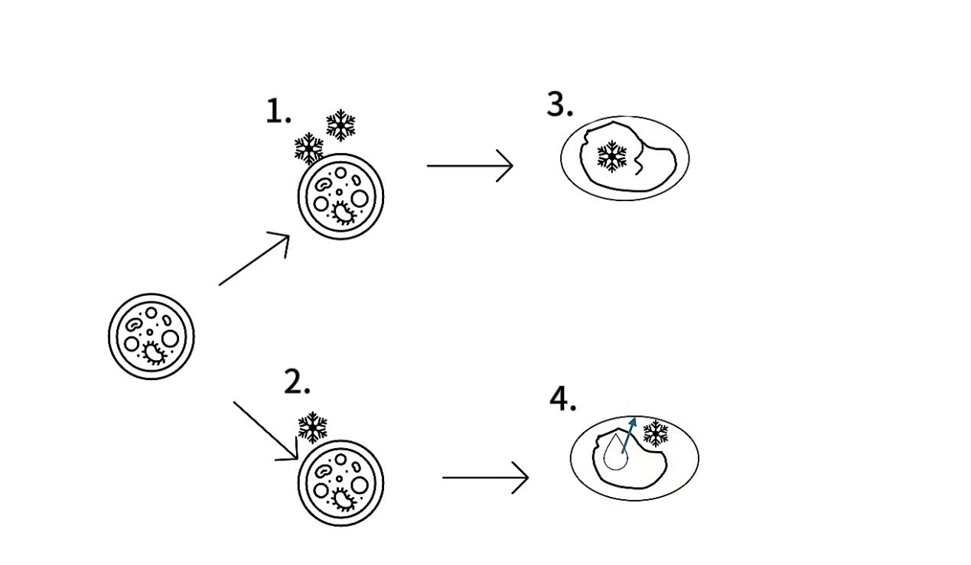
FSMILE 2025
The Freezing Protection Mechanism of Vegetable Cells Based on the Synergy between Antifreeze Proteins and Physical Fields
October 04-07, 2025
@Morioka & ZOOM Cloud
J.YAN¹, Y.HU²
1Hainan Tropical Ocean University, Sanya, China
2Hainan Tropical Ocean University, Sanya, China
International Symposium on Food Communications and Sustainable Agri-Aqua Food Systems
Connecting Primary Industries, Academia, and Society through the SDGs
Contact Information:
Just highlight this text and replace with your own text.
Introduction
Vegetables are perishable and prone to spoilage. Long-term storage requires low temperatures. However, during the freezing preservation of vegetables, water molecules within the cells form ice crystals. The volume expansion can cause mechanical damage to the cells, leading to osmotic pressure imbalance and dehydration of the cells. Eventually, this results in a decline in the quality of the vegetables and a reduction in their commercial value.
Results
Conclusions
The combination of antifreeze proteins with different physical fields has the potential to further enhance the efficiency of cryopreservation, but the parameter optimization of the physical field still relies on empirical experiments, which is relatively inefficient. In the future, machine learning algorithms such as neural networks and random forests can be combined to analyze the complex nonlinear relationship between ice crystal morphology, cell survival rate and physical field parameters during the freezing process, and establish an intelligent regulation model.
Antifreeze proteins are a type of protein with the function of modifying ice crystal morphology. By specifically binding to the surface of ice crystals to inhibit the recrystallization process, they can effectively reduce the mechanical damage caused by ice crystals. At the same time, they can stabilize the osmotic pressure balance of cells, protect the functional integrity of subcellular organelles, and enable organisms to survive normally below 0℃.
The traditional freezing method has disadvantages such as high energy consumption, large loss and significant loss of food quality. Therefore, with the continuous development of science and technology, the freezing technology involving physical fields has been widely applied in the food processing industry.
Both physics and antifreeze proteins have their own disadvantages in freezing, and studies on their synergistic effect are quite rare.
AIM
Aiming to reduce the impact of freezing on the nutritional quality of plant cells ,Increase the production of antifreeze proteinand low-loss vegetable freezing and preservation technologies.
.
1.Rapid freezing; 2. Uniform-speed freezing; 3. Rapid intracellular crystallization causes damage to the cell membrane and intracellular proteins; 4.Crystals form outside the cell membrane, and intracellular water seeps out, causing damage to the cell membrane and intracellular proteins.
Acknowledgements
Thanks to teacher Hu Yaqin and senior Liu Songqi for their guidance.
Properties and homologous proteins of antifreeze proteins from different plants
Method
Study the mechanism of ice crystal formation within plant cells and explore the research progress of antifreeze proteins
Briefly describe the molecular mechanism by which AFPs inhibits ice crystal growth through ice-binding sites (IBS) during vegetable freezing.
Briefly describe the physical effects of physical fields (such as high pressure, ultrasonic waves, magnetic fields, etc.) in regulating the nucleation and distribution of ice crystals.
Propose a collaborative model of "physical field enhancing the function of antifreeze proteins".
Based on the above analysis, the possibility of "two-path synergy model" between the two was explored.
sample | Causes of deterioration | Performance | Deterioration mechanism | Traditional solutions
Carrot | Recrystallization | The number of ice crystals decreases, and a bonding reaction occurs, causing the size of the ice crystals to increase | Small ice crystals have high surface energy and instability | Lower storage temperature
Cabbage | Enzymatic reaction | Enzymatic Browning and other enzymatic reactions lead to deterioration | Enzyme release mixes with the substrate | Blanching
Potato | Freezing and cracking | Cracks appeared on the surface of the product and extended inward | Tensile stress generated by rapid freezing, when the stress exceeds the fracture strength | Pre-cooling
Peach | Mechanical damage | Cell integrity is disrupted, tissues are damaged, and nutrients are lost along with the SAP, leading to product deterioration | In frozen products, the formation of ice causes the separation of water from solutes | Quick-freezing
References
[1] DOUCET C J, BYASS L, ELIAS L,. Distribution and Characterization of Recrystallization Inhibitor Activity in Plant and Lichen Species from the UK and Maritime Antarctic[J/OL]. Cryobiology, 2000, 40(3): 218-227. DOI:10.1006/cryo.2000.2241.
[2] MIDDLETON A J, BROWN A M, DAVIES P L, . Identification of the ice‐binding face of a plant antifreeze protein[J/OL]. FEBS Letters, 2009, 583(4): 815-819. DOI:10.1016/j.febslet.2009.01.035.
[3] ZHANG D Q, LIU B, FENG D R, Significance of conservative asparagine residues in the thermal hysteresis activity of carrot antifreeze protein[J/OL]. Biochemical Journal, 2004, 377(3): 589-595. DOI:10.1042/bj20031249.
[4] ZENG W, NIU L, WANG Z, . Application of an antibody chip for screening differentially expressed proteins during peach ripening and identification of a metabolon in the SAM cycle to generate a peach ethylene biosynthesis model[J/OL]. Horticulture Research, 2020, 7(1): 31. DOI:10.1038/s41438-020-0249-9.

